Slide 1
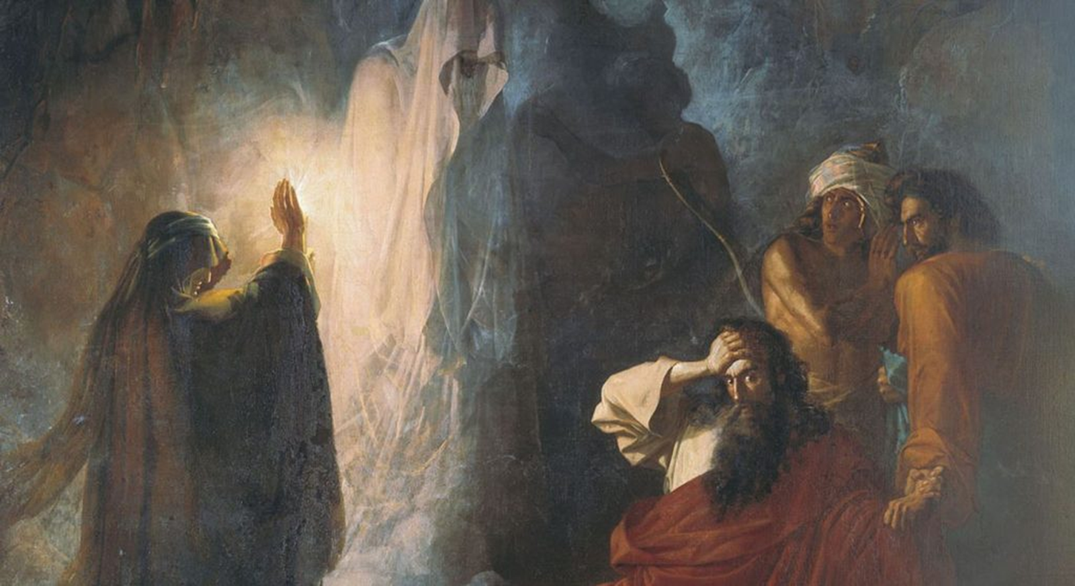
We Missed Halloween by Two Weeks
1 Samuel 28

Slide 2

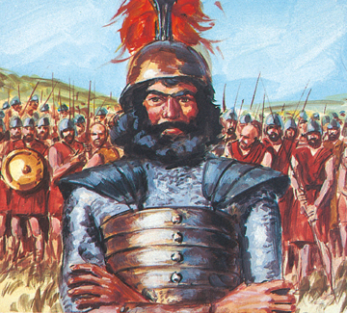
WAR!
Vs 1: The danger: if you’re living with the world, they’ll have you turning against God’s people.
Vs 2: David dissimulates.

Slide 3


WORRY

Slide 4
Isaiah 57:1 The righteous perisheth, and no man layeth it to heart: and merciful men are taken away, none considering that the righteous is taken away from the evil to come.

Slide 5
Deuteronomy 18:9-14 When thou art come into the land which the LORD thy God giveth thee, thou shalt not learn to do after the abominations of those nations. 10 There shall not be found among you any one that maketh his son or his daughter to pass through the fire, or that useth divination, or an observer of times, or an enchanter, or a witch, 11 Or a charmer, or a consulter with familiar spirits, or a wizard, or a necromancer. 12 For all that do these things are an abomination unto the LORD: and because of these abominations the LORD thy God doth drive them out from before thee. 13 Thou shalt be perfect with the LORD thy God. 14 For these nations, which thou shalt possess, hearkened unto observers of times, and unto diviners: but as for thee, the LORD thy God hath not suffered thee so to do.

Slide 6
WORRY
Saul began well but now he’s antichrist-ing!
When you are fighting the wrong battles, you lose the critical battles.

Slide 7
Ephesians 5:15-16 See then that ye walk circumspectly, not as fools, but as wise, 16 Redeeming the time, because the days are evil.
Isaiah 57:20-21 But the wicked are like the troubled sea, when it cannot rest, whose waters cast up mire and dirt.
21 There is no peace, saith my God, to the wicked.

Slide 8
The problem? Saul didn’t fear God and so, Saul rebelled against God’s Word.

Slide 9
Romans 3:10-18 As it is written, There is none righteous, no, not one: 11 There is none that understandeth, there is none that seeketh after God. 12 They are all gone out of the way, they are together become unprofitable; there is none that doeth good, no, not one. 13 Their throat is an open sepulchre; with their tongues they have used deceit; the poison of asps is under their lips: 14 Whose mouth is full of cursing and bitterness: 15 Their feet are swift to shed blood: 16 Destruction and misery are in their ways: 17 And the way of peace have they not known: 18 There is no fear of God before their eyes.

Slide 10
2 Timothy 1:7 For God hath not given us the spirit of fear; but of power, and of love, and of a sound mind.
When you KNOW that God is with you, you do not fear!

Slide 11
Job 33:14-18 For God speaketh once, yea twice, yet man perceiveth it not. 15 In a dream, in a vision of the night, when deep sleep falleth upon men, in slumberings upon the bed; 16 Then he openeth the ears of men, and sealeth their instruction, 17 That he may withdraw man from his purpose, and hide pride from man. 18 He keepeth back his soul from the pit, and his life from perishing by the sword.

Slide 12
Isaiah 55:6-7 Seek ye the LORD while he may be found, call ye upon him while he is near: 7 Let the wicked forsake his way, and the unrighteous man his thoughts: and let him return unto the LORD, and he will have mercy upon him;
and to our God, for he will abundantly pardon.

Slide 13
Bible rejectors can’t come to the truth.

Slide 14
Proverbs 1:20-33 Wisdom crieth without; she uttereth her voice in the streets: 21 She crieth in the chief place of concourse, in the openings of the gates: in the city she uttereth her words, saying, 22 How long, ye simple ones, will ye love simplicity? and the scorners delight in their scorning, and fools hate knowledge? 23 Turn you at my reproof: behold, I will pour out my spirit unto you, I will make known my words unto you. 24 Because I have called, and ye refused; I have stretched out my hand, and no man regarded; 25 But ye have set at nought all my counsel, and would none of my reproof: 26 I also will laugh at your calamity; I will mock when your fear cometh;

Slide 15
Proverbs 1:27 When your fear cometh as desolation, and your destruction cometh as a whirlwind; when distress and anguish cometh upon you. 28 Then shall they call upon me, but I will not answer; they shall seek me early, but they shall not find me: 29 For that they hated knowledge, and did not choose the fear of the LORD: 30 They would none of my counsel: they despised all my reproof. 31 Therefore shall they eat of the fruit of their own way, and be filled with their own devices. 32 For the turning away of the simple shall slay them, and the prosperity of fools shall destroy them. 33 But whoso hearkeneth unto me shall dwell safely, and shall be quiet from fear of evil.

Slide 16

WITCHCRAFT

Slide 17
Leviticus 19:31 Regard not them that have familiar spirits, neither seek after wizards, to be defiled by them: I am the LORD your God.
Exodus 22:18 Thou shalt not suffer a witch to live.
Leviticus 20:6 And the soul that turneth after such as have familiar spirits, and after wizards, to go a whoring after them, I will even set my face against that soul, and will cut him off from among his people.

Slide 18
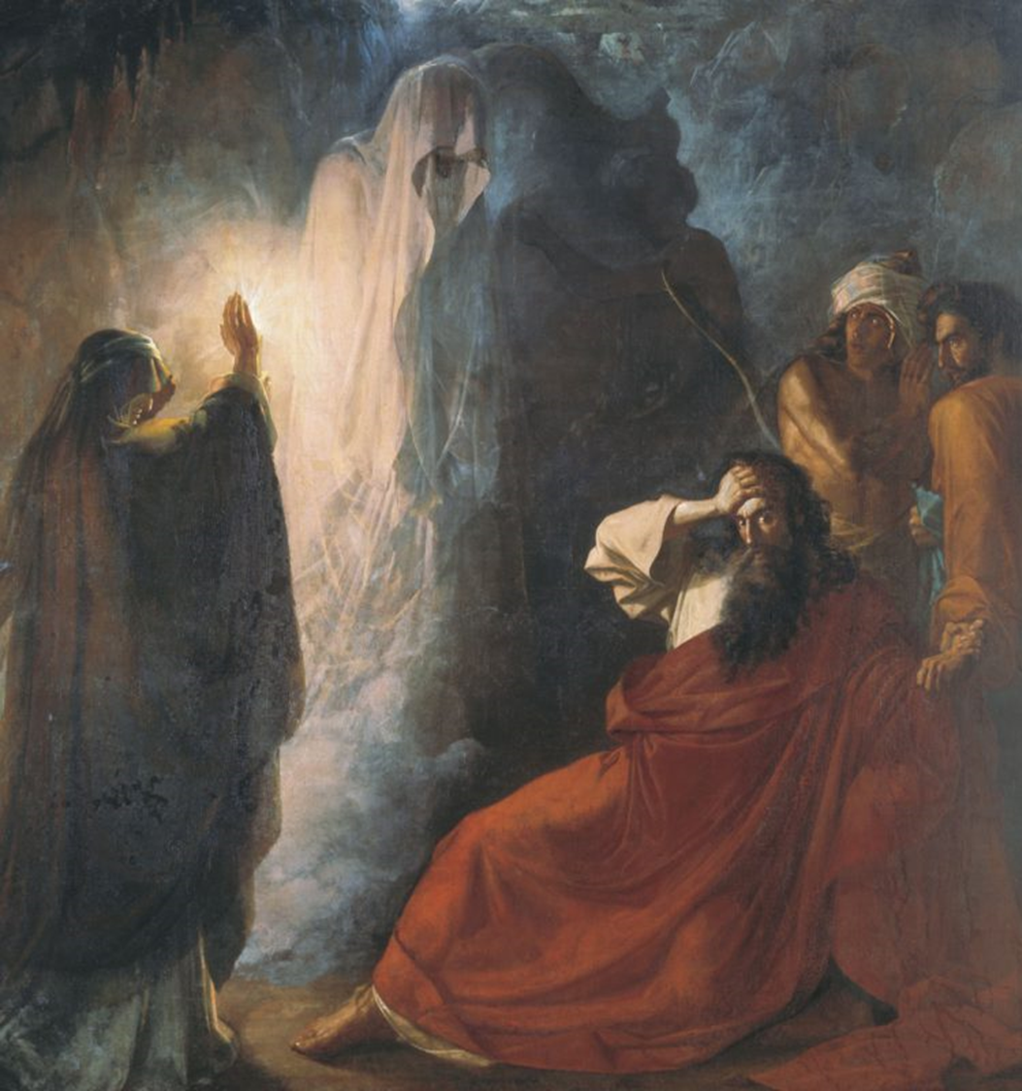
WITCHCRAFT
People hide when they perpetrate evil.
A séance only works through a demon. Familiar spirit.

Slide 19
1 Chronicles 10:13-14 So Saul died for his transgression which he committed against the LORD, even against the word of the LORD, which he kept not, and also for asking counsel of one that had a familiar spirit, to enquire of it;
14 And enquired not of the LORD: therefore he slew him, and turned the kingdom unto David the son of Jesse.

Slide 20
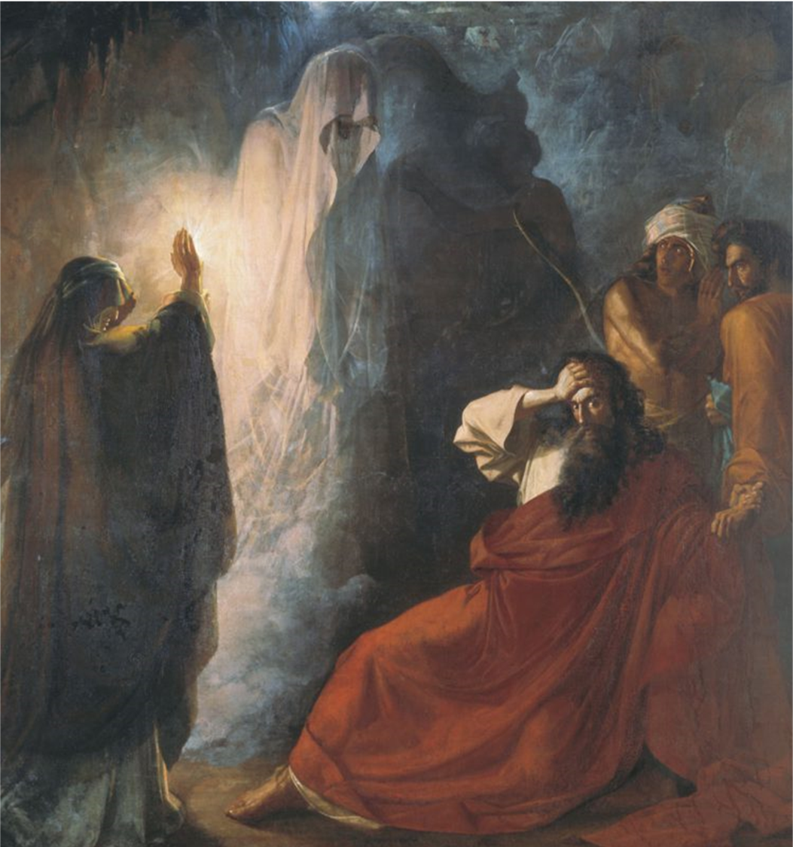
WITCHCRAFT
People hide when they perpetrate evil.
A séance only works through a demon. Familiar spirit.
Saul is commanding evil in the LORD’s name!

Slide 21
WITCHCRAFT
Notice what the Word says happened that night.
  This witch was shocked.
  She saw “gods”= the Elohim.
  The Word of God agrees with Saul’s perception. This is Samuel.
  Samuel is a prophet!
  Postmortem prophecy!!!

Slide 22
Witchcraft and divination are still sinful and forbidden in the Word of God.

Slide 23
WILT
Why was Saul fasting before a big battle?
Everything is backwards here!
Type of antichrist – Saul’s “last supper.”
John 13:30 He then having received the sop went immediately out: and it was night.

Slide 24
We Missed Halloween by Two Weeks
1 Samuel 28

